Slide 1
Feedback

Slide 2
Critial

Slide 3
Performance
NO This is not acceptable, if the user clicks photography, it loads 2361 records from the Event table and doesn’t load
The calendar correctly!!!! This is CRITIAL and needs to be fixed by COB.
I have updated PROD_COPY with events from the production db. So now there are 14717 records in the db.
You can now see that performance is a real issue and this needs to be resolved ASAP by constraining the date period of the selected users.
Fixed
We have made significance changes on the scheduler controller ,as per now we are loading records only for selected users so we do not need to change any date period field- by doing this we reduced the db hits because it will also cost the performance issue in the coming future.
Please give your feedback on this.

Slide 4
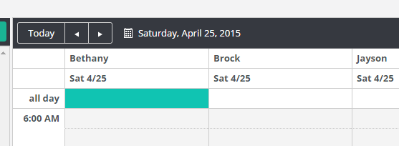
Data Retrieval. So It seems you are retrieving all event data for the selected calendars. Wouldn’t it make sense to break this up based on the a predefined date range and query again when outside of the existing data set. This is going to be a bottle neck when we link up production accounts. => Not fixed. This will be taken up tomorrow
Fixed with above issue no need to do this.
NO This is not acceptable, if the user clicks photography, it loads 2361 records from the Event table and doesn’t load
The calendar correctly!!!! This is CRITIAL and needs to be fixed by COB.

Slide 5
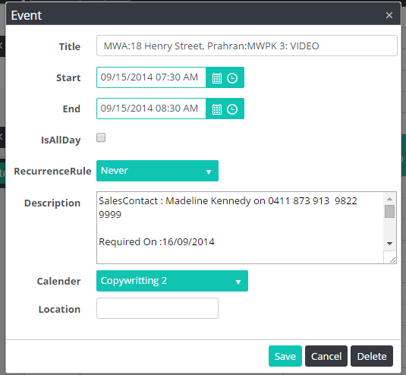
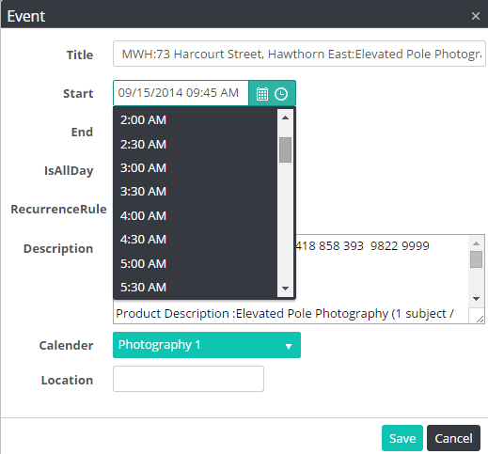
1. If the user edits the event for the first time, the edit popup has a delete button. 2. If the user saves, and edits again, delete button is gone. 2.1 If the user presses cancel, it delete the event.
Critical
In Progress– We raised Ticket to Kendo support team waiting for their response.

Slide 6
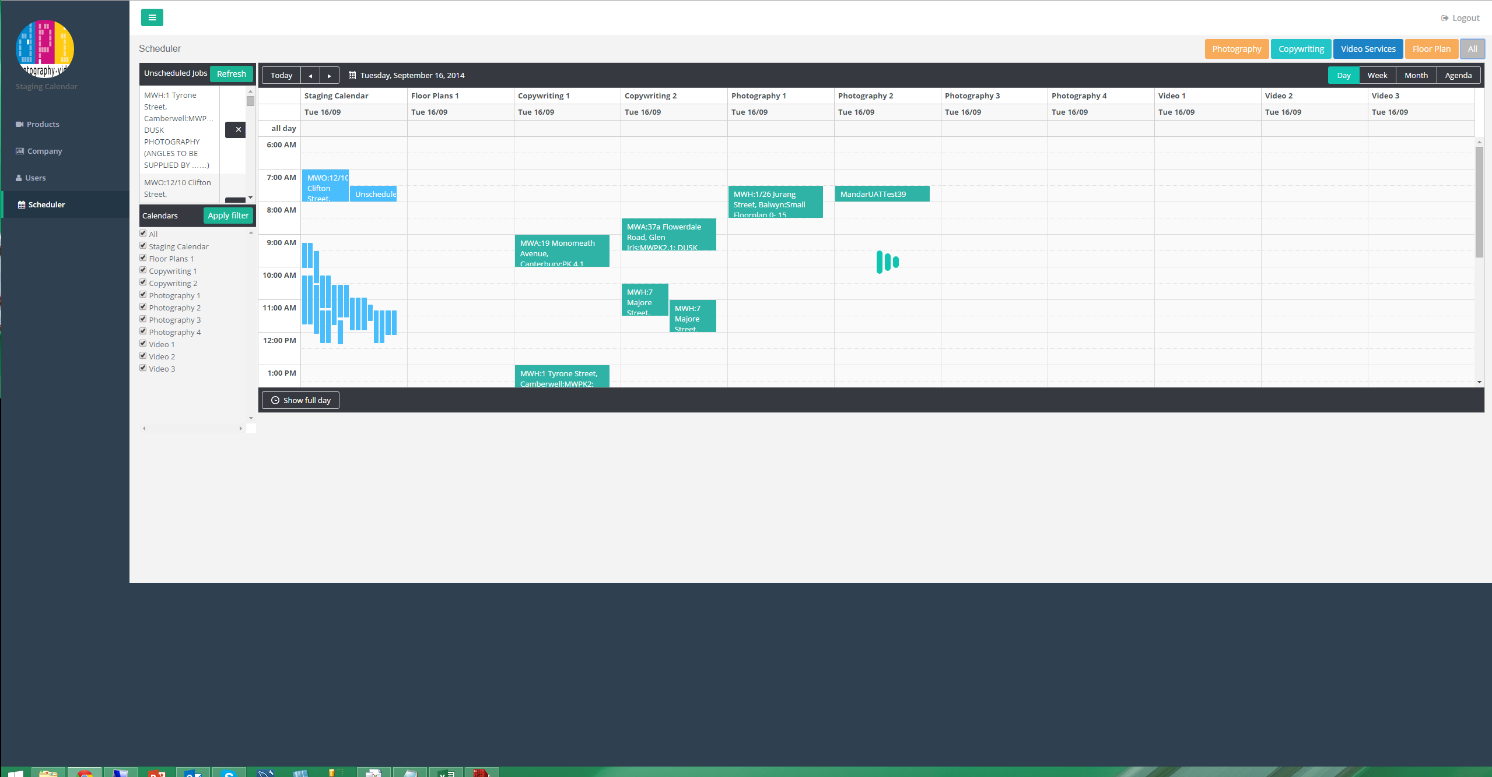
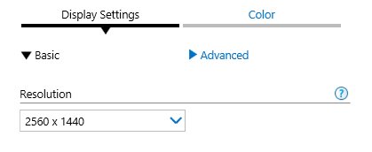
On large Monitor we have the ability to show the entire working hours on the screen. Make sure the screen uses all vertical space on the screen. Each user will have access to large screens.
FIXED but you have created a NEW horizontal issue. See Next Slide

Slide 7
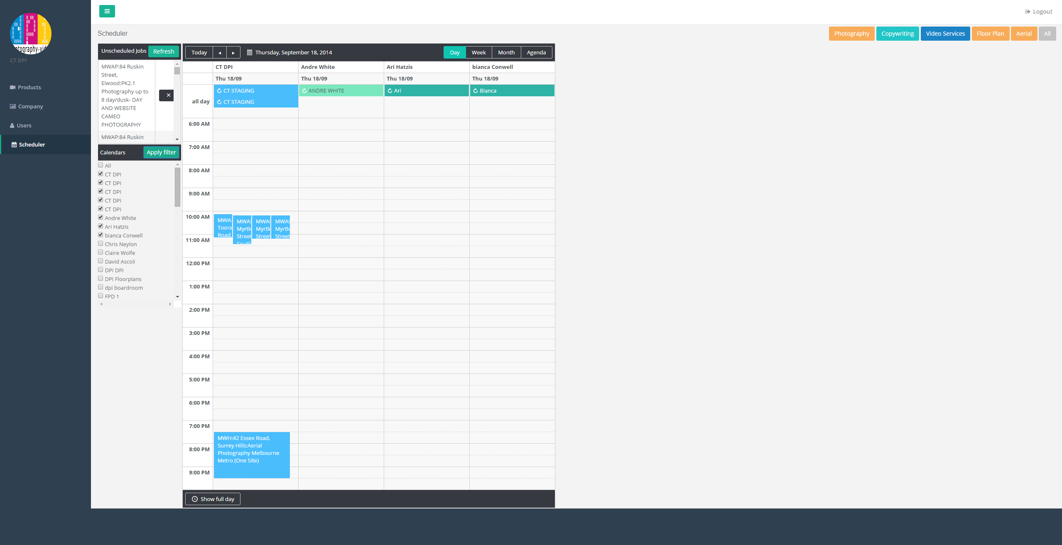
Now it doesn’t scale horizontally!

Slide 8
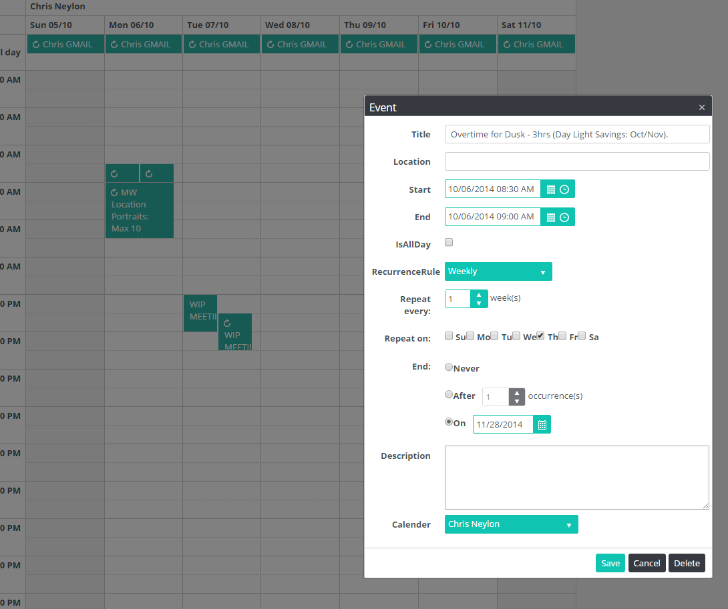
The dates within the calendar are US date format.

Slide 9
High Priority

Slide 10
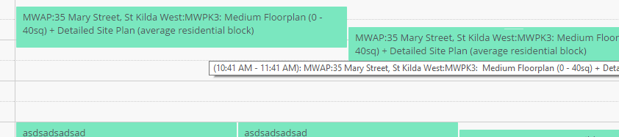
Client reported that when dragging from Staging to Individual Calendar, the times are not defaulting to either on the hour, or on the half our. They are being dropped at random times.
– We have done R&D on that and find in Kendo grid the dragged event
always drops in the slot where ‘top left corner’ of the event rectangle lies.
This is kendo scheduler behavior please refer
http://demos.telerik.com/kendo-ui/scheduler/index
If user wants to increase the event time duration then user needs to stretch the event
by pressing the left mouse button and stretch as desired.

Slide 11
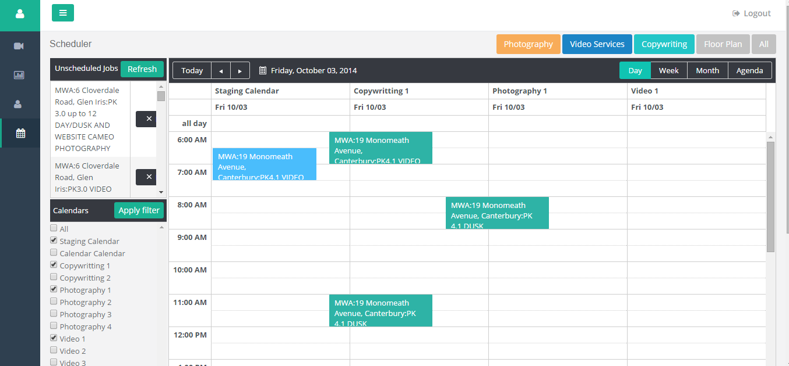
When the user minimises the menu, the calendar items don’t align with the specific allocated calendar user. They seem merge between calendars.
Issue Partially Fixed Please give your feedback on this.

Slide 12
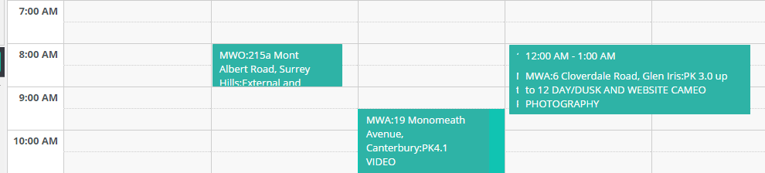
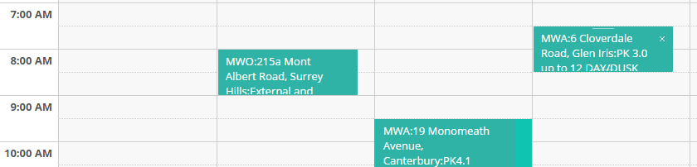
When dragging from Unscheduled Jobs to a specific calendar, the final drag position is not where the user dropped it.
– We have done R&D on that and find in Kendo grid the dragged event
always drops in the slot where ‘top left corner’ of the event rectangle lies.
This is kendo scheduler behavior please refer
http://demos.telerik.com/kendo-ui/scheduler/index
Same behaviour we found at telerik demo site, please refer above given link for the same.

Slide 13
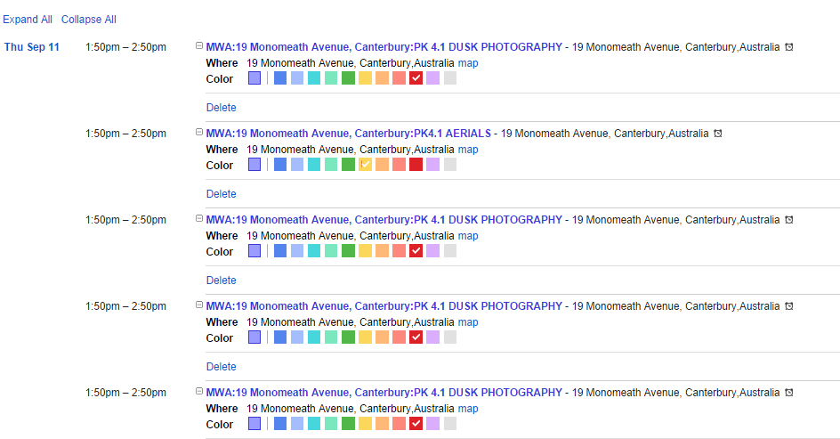
When events are created in Google they are created with a COLOUR and DURATION according to the data stored in ProductSchedule. When moving allocating the event from Unscheduled Jobs to a specific calendar, it should maintain these values. Currently this information is being lost.
WHY HAS THIS NOT PROGRESSED!
In Progress– not focused on this 17 Sep

Slide 14
Events are created with a default duration, ie in this example 1:50 – 2:50pm, so duration = 60 mins. When we move from staging to specific calendar, it should keep this duration, 60 mins, 90 mins what ever the difference is between start/end time as the duration on the users calendar when dropped.
More Info Provided.
In Progress – not focused on this 17 Sep
WHY HAS THIS NOT PROGRESSED!

Slide 15
Low Priority

Slide 16
Conversation on Notifictions of Google Changes.
Hi Chris,
This is ok and we will see if time permits. But my opinion is to let the system stabilize (and prepare for UAT) rather than taking any new change at this point. We are still incorporating changes and today and tomorrow we want to focus fully on testing special scenarios.
Regards,
Mandar
From: Christopher Kerr [mailto:christopher.kerr@zerofootprint.com.au] Sent: Thursday, 11 September 2014 5:32 PM To: Mandar Joshi Cc: Shailesh Kulkarni; Swapnil Gade; Trilok Sharma Subject: RE: Order Management System: Status 9th Sept
Thanks for the prompt response.
Can we have some visual identifier on the db. to let the user know that the specific calendar has changed. Ie a notification to let them know. In the bootstrap example there was notifications in the top right.
If we could have a notification present that a specific users calendar has changed and provide them the option to refresh?
CK
Regards
Christopher Kerr
Director
Zero Footprint
Email: Christopher.kerr@zerofootprint.com.au
Web: www.zerofootprint.com.au mobile: +61 (0) 412 877 954
direct: +61 (3) 9028 8708 skype: CKUK00
From: Mandar Joshi [mailto:Mandar.Joshi@e-zest.in] Sent: Thursday, 11 September 2014 4:54 PM To: Christopher Kerr Cc: Shailesh Kulkarni; Swapnil Gade; Trilok Sharma Subject: RE: Order Management System: Status 9th Sept
Hi Chris,
Comments inline
From: Christopher Kerr [mailto:christopher.kerr@zerofootprint.com.au] Sent: Thursday, September 11, 2014 4:36 PM To: Mandar Joshi Cc: Shailesh Kulkarni; Swapnil Gade; Trilok Sharma Subject: RE: Order Management System: Status 9th Sept
Mandar,
I have noticed a couple of things with the Scheduler.
When the scheduler loads, its loading the default calendar, but not populating with events. Its not until you select this calendar and apply filter will the events come through, this needs to be addressed.
Yes this is known and we will be fixing it today.
Secondly, If a change is made In google and push notification is received, does the Scheduler get informed of this change ie refresh the data set or something of the like. I’m concerned about how changes in google will display.
Currently there is no explicit mechanism for user to know if something has explicitly changed on google. In fact push notification pushes the changes made on google calendar by our UI + changes made directly on google calendar so we cannot explicitly determine who has changed google calendar. User will be able to see latest data only by refreshing the calendar manually.
We can also define automatic refresh of grid after certain time period so that latest events are displayed over our calendar. However not sure how much performance overhead it will add.
CK
Regards
Christopher Kerr
Director
Zero Footprint
Email: Christopher.kerr@zerofootprint.com.au
Web: www.zerofootprint.com.au mobile: +61 (0) 412 877 954
direct: +61 (3) 9028 8708 skype: CKUK00

Slide 17
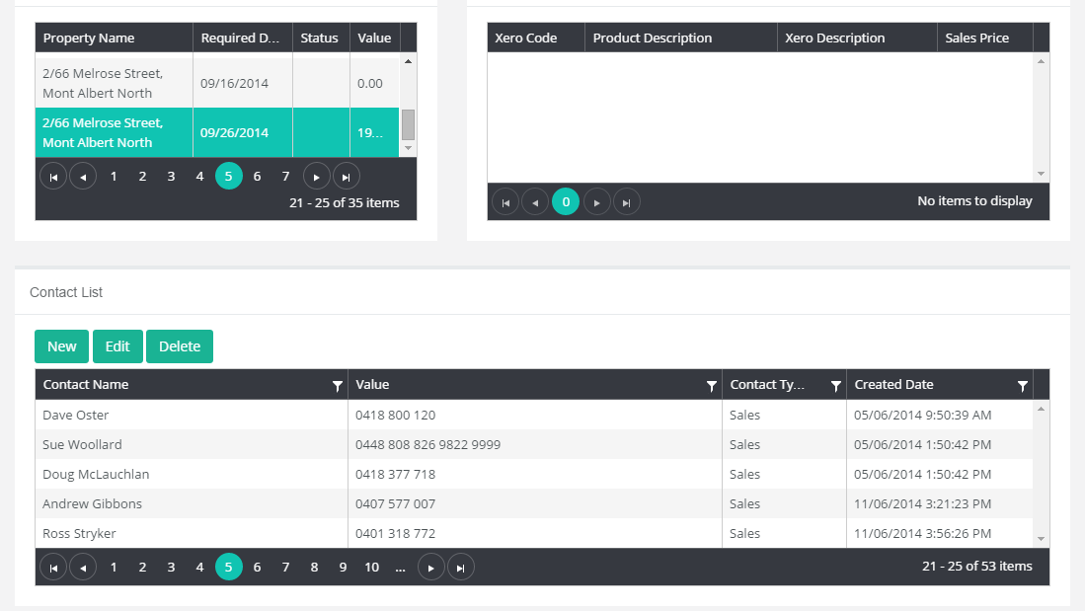
1. If I select the Property Name in the Order History Module, it should constrain the ContactList for only those contacts against the selected Order, and the Product History of the current order. 2. The Order History Module needs to show more records. It should be set to 10 records.

